Slide 1
8 BIT - TIMERS

Slide 2
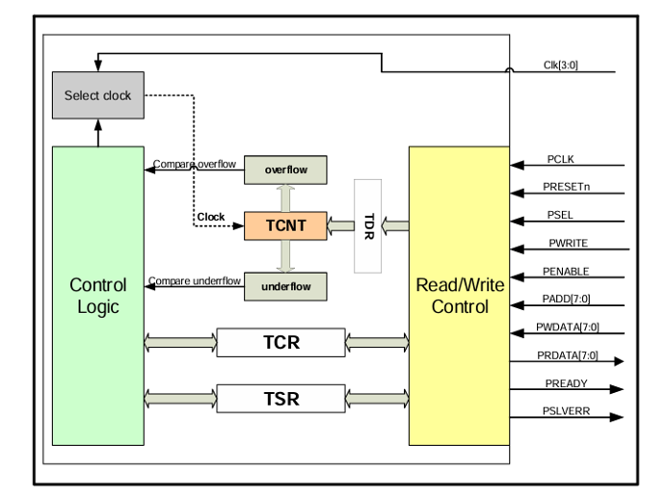
Block diagram
Figure 0: Clock diagram of Timer Block( Timer)

Slide 3
I. Register definitions
TCNT (8-bit)
Timer Counter
TDR (8-bit)
Timer Data Register
TCR (8-bit)
Timer Control Register
TSR (8-bit)
Timer Status Reg
Description:
TCNT (Timer Counter Register):
Holds the current count value of the timer.
The timer increments or decrements this register based on the TCR settings.
It can be loaded with a value from TDR based on the control signals.
TDR (Timer Data Register):
Holds the value to be loaded into TCNT when the load signal in TCR is set.
It is used for presetting the counter with a specific starting value.
TCR (Timer Control Register):
Controls the operation of the timer, including enabling/disabling the timer, selecting the clock source, and setting the mode (count up or down).
Bits in this register determine how the timer behaves.
TSR (Timer Status Register):
Reflects the status of the timer, including flags: overflow and underflow conditions.
These flags can be cleared or read based on certain control logic.

Slide 4
1. Bit definitions for TCR
Bit position | 7 | 6 | 5 | 4 | 3 | 2 | 1 | 0
Bit function | Load | x | Up/Dw | enable | x | x | cks | cks
Table 1:Bit definitions for TCR
Bit 7 (load): This bit controls the loading of the TDR (Timer Data Register) value into TCNT. When set to 1, the timer counter will load the value from the TDR.
Bit 6 (Unused/X): This bit is unused (denoted by X in the diagram).
Bit 5 (up_down): This bit controls whether the timer counts up or down. If set to 1, the timer will count up. If set to 0, the timer will count down.
Bit 4 (enable): This bit controls whether the timer is enabled. When set to 1, the timer is active, and when set to 0, the timer is disabled.
Bits 3 and 2 (Unused/X): These bits are unused.
Bits 1-0 (cks): These two bits are used for clock selection. The value of cks determines the clock division factor used for the timer.

Slide 5
2. Bit definitions for TSR
Bit position | 7 | 6 | 5 | 4 | 3 | 2 | 1 | 0
Bit function |  |  |  |  |  |  | underflow | overflow
Table 2: Bit definitions for TCR
Overflow Detection: If the value of TCNT transitions from 255 to 0, the overflow flag is set to indicate an overflow condition.
Underflow Detection: If the value of TCNT transitions from 0 to 255, the underflow flag is set to indicate an underflow condition.

Slide 6
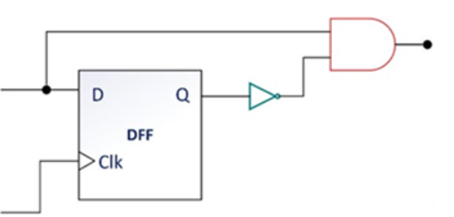
I. Clock selection
clk_sel[1:0]
T2
T4
T8
T16
Clk_in_ena
MMMCLK
MUX
4:1
clk_in
~clk_in_prev
clk
Figure 1: Description of the operation of clock_selection

Slide 7
1. Inputs and Outputs
Inputs:
clk_sel [1:0]: A 2-bit selection signal used to choose which clock from clk_in should be enabled.
clk_in [3:0]: A 4-bit input representing four different clock signals.
Output:
clk_ena: The enabled clock signal, determined by the clk_sel value.
clk_sel = 0: clk_ena receives the value from clk_in_ena[0]. clk_sel = 1: clk_ena receives the value from clk_in_ena[1]. clk_sel = 2: clk_ena receives the value from clk_in_ena[2]. clk_sel = 3: clk_ena receives the value from clk_in_ena[3]. If clk_sel is invalid, clk_ena will be set to 0.

Slide 8
2. Internal Registers
clk_in_prev [3:0]:
This is a 4-bit register that stores the previous value of clk_in.
It is delayed by one clock cycle.
clk_in_prev <= clk_in;
clk_in_ena [3:0]:
This is a 4-bit register that stores the clock-enable signals for each of the clocks in clk_in.
The signals are generated by detecting the rising edges of the individual clocks in clk_in.
clk_in_ena <= clk_in & ~clk_in_prev;

Slide 9
II. Timer counting logic
count
==
TCNT
0
AND
OVERFLOW
clk_ena
enable
Up_Dw
Load
Start_counter
Prev_count
DFF
Up
==
255
count
==
255
AND
UDERFLOW
DFF
Prev_count
Dw
==
0
Figure 2: Description of the operation of the counter

Slide 10
1. Inputs and Outputs
Inputs:
clk_ena: Clock enable signal.
start_counter: Initialization value for the counter (8-bit).
up_down: Signal determining whether to count up (1) or down (0).
load: Signal to load a value into the counter.
enable: Signal to enable the counter.
Outputs:
overflow: Overflow signal (1-bit).
underflow: Underflow signal (1-bit).
Functionality:
count: Main counter register (8-bit).
Prev_count: Previous value of the counter register (8-bit).

Slide 11
2. Main Blocks
Counter Update Logic:
When load is active, count is loaded with the value from start_counter.
When enable and clk_ena are active:
If up_down is 1, count is incremented by 1.
If up_down is 0, count is decremented by 1.
Update Previous Counter Value:
The value of prev_count is updated from count.
Overflow & Underflow Logic:
overflow: Activated when count is 0 and prev_count is 255.
underflow: Activated when count is 255 and prev_count is 0.

Slide 12
III. APB Controller
APB Controller
Input
Output
clk
rst_n
Psel
Penable
Pwrite
Paddr
Pwdata
Overflow
underflow
State Machine
prdata
pready
pslverr
start_counter
load
up_down
enable
clk_sel
IDLE --> SETUP --> ACCESS --> IDLE
Register Block
reg_TDR, reg_TCR, reg_TSR
Write Logic Block
Read Logic Block
Ready/Error Logic Block
Figure 3: Operation of the apb_controller

Slide 13
1. Input Signals Block
clk: Clock signal.
rst_n: Asynchronous reset signal, active-low.
psel: Peripheral select signal.
penable: Enable signal for operations.
pwrite: Signal to determine write operation.
paddr [7:0]: Address of the peripheral.
pwdata [7:0]: Data to be written to the peripheral.
overflow: Signal indicating data overflow.
underflow: Signal indicating data underflow.

Slide 14
2. State Machine
state: Variable storing the current state (IDLE, SETUP, ACCESS).
next_state: Variable storing the next state based on conditions.
IDLE: Idle state.
If both psel and penable are 1, the state machine transitions to SETUP
Otherwise, it stays in the IDLE state
SETUP: Setup state.
If both psel and penable are 1, the state machine transitions to ACCESS
Otherwise, it returns to the IDLE state
ACCESS: The controller performs the access operation (read/write) on the registers.
After completing the access, the state machine returns to the IDLE state.

Slide 15
3. Register Block
reg_TDR: Timer Data Register.
reg_TCR: Timer Control Register.
reg_TSR: Timer Status Register.
This block stores and manages necessary values based on read/write operations.
4. Write Logic Block
If the system is in the ACCESS state and the signals psel, penable, and pwrite are all activated, data writing will occur.
paddr determines which register will receive the value from pwdata:
If paddr = 8'h0, the value of pwdata will be written to the reg_TCR register.
If paddr = 8'h1, the value of pwdata will be written to the reg_TDR register.
If paddr = 8'h2, the value of pwdata will be written to the reg_TSR register.
If overflow or underflow occurs, the value of reg_TSR is updated with the corresponding bits.

Slide 16
5. Read Logic Block
If the system is in the ACCESS state, and both the psel and penable signals are activated, while pwrite is not activated (set to 0), a read operation will occur.
The paddr signal determines which register will be read:
If paddr = 0, the value of the reg_TDR register will be placed into prdata.
If paddr = 1, the value of the reg_TCR register will be placed into prdata.
If paddr = 2, the value of the reg_TSR register will be placed into prdata.
If the address paddr is invalid, the value of prdata will be reset to 0.
6. Ready/Error Logic Block
PREADY:
When in the ACCESS state, the signal pready will be set to 1; otherwise, it will be 0.
PSLVERR (Error Detection):
If the system is in the ACCESS state, and the signals psel and penable are activated, and the address paddr is greater than 7, the error signal pslverr will be set to 1.
If these conditions are not met, pslverr will be 0.

Slide 17
7. Output Signals Block
prdata [7:0]: Data read from the peripheral.
pready: Ready signal.
pslverr: Error signal.
start_counter [7:0]: Value of the reg_TDR register.
load: Load signal from bit 7 of reg_TCR.
up_down: Control signal for up/down from bit 5 of reg_TCR.
enable: Enable signal from bit 4 of reg_TCR.
clk_sel [1:0]: Clock select signal from bits [1:0] of reg_TCR.

Slide 18
8. Clear flag
First Condition (Hardware Write):
If overflow or underflow occurs (condition (overflow | underflow)):
reg_TSR will be updated with the value {6'b0, underflow, overflow}.
Second Condition (Software Write):
If state == ACCESS, and pwrite are all true (condition (state == ACCESS) & pwrite)):
If paddr == 8'h02:
Clear the overflow and underflow flags:
reg_TSR[0] is updated by reg_TSR[0] & ~1’b1 (Clear the overflow flag).
reg_TSR[1] is updated by reg_TSR[1] & ~1’b1 (Clear the underflow flag).

Slide 19
IV. top_module
APB Controller
Clock Selection
Clk
rst_n
Psel
Penable
Pwrite
Paddr
Pwdata
overflow
underflow
Clock Selection
clk
rst_n
clk_sel
clk_in
prdata•
pready•
pslverr•
start_counter•
Up_down•
load•
enable•
clk_sel•
clk_ena •
Counter
Clock Selection
clk
rst_n
clk_ena
start_counter
up_down
load
enable
Overflow •
Underflow•
Figure 4: Connection of the top_module

Slide 20
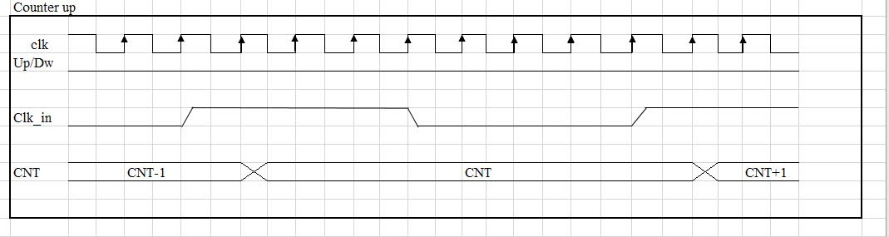
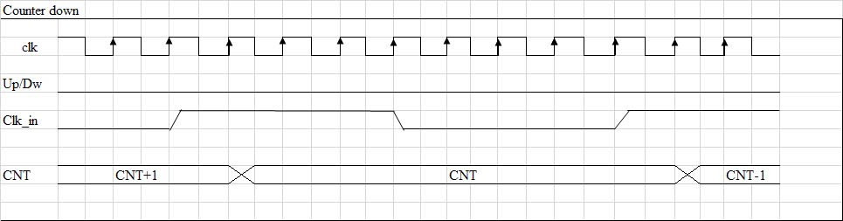
V. Functional Timing
Figure 5: Counter up timing
Figure 6: Counter down timing

Slide 21
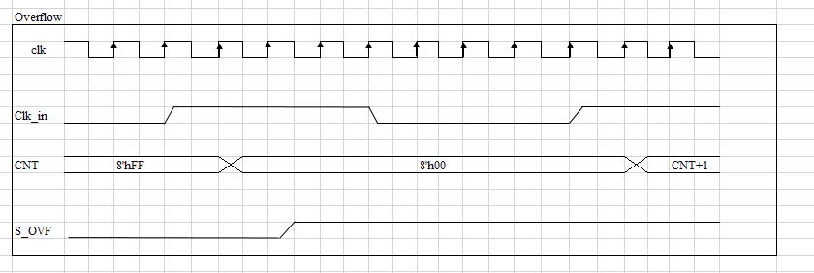
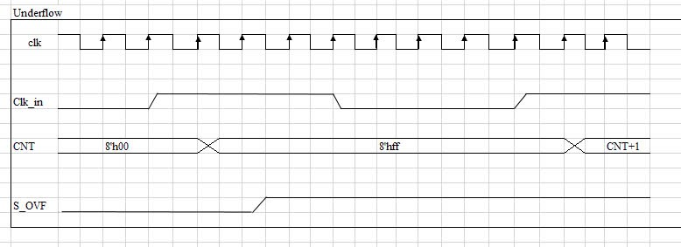
Figure 7: Overflow timing
Figure 8: Underflow timing

